Slide 1

Dominic Hibbin
Assessment Manager
dhibbin@rdac.co.uk

Slide 2

Importance of driving
occupation
mobility
employment
What it
means
social
inclusion
quality
of life
independence

Slide 3

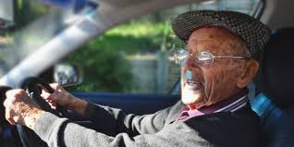
How can RDAC help?
We are a charity providing assessments for people with medical conditions or disabilities to help them regain or maintain their independence in driving and outdoor mobility.
Case
DVLA
Leal
Manager

Slide 4
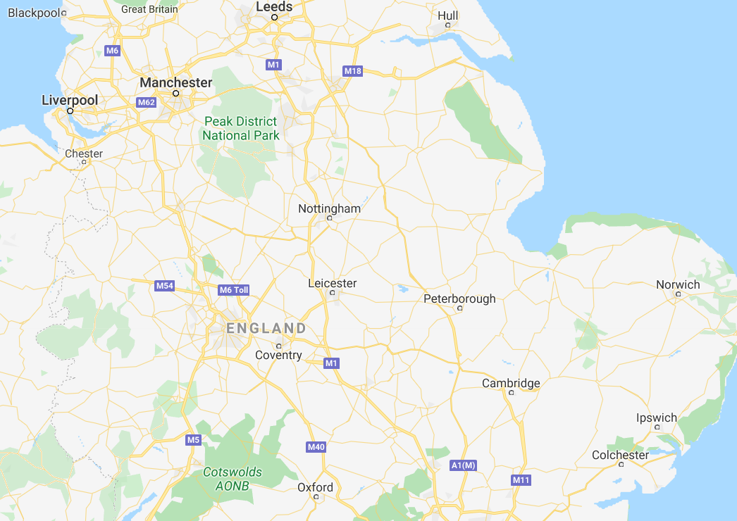



Accrington
Scunthorpe
www.rdac.co.uk
0300 300 2240
Cannock
Shrewsbury
Wolverhampton
Meriden HQ
Northampton
Worcester
Aylesbury

Slide 5
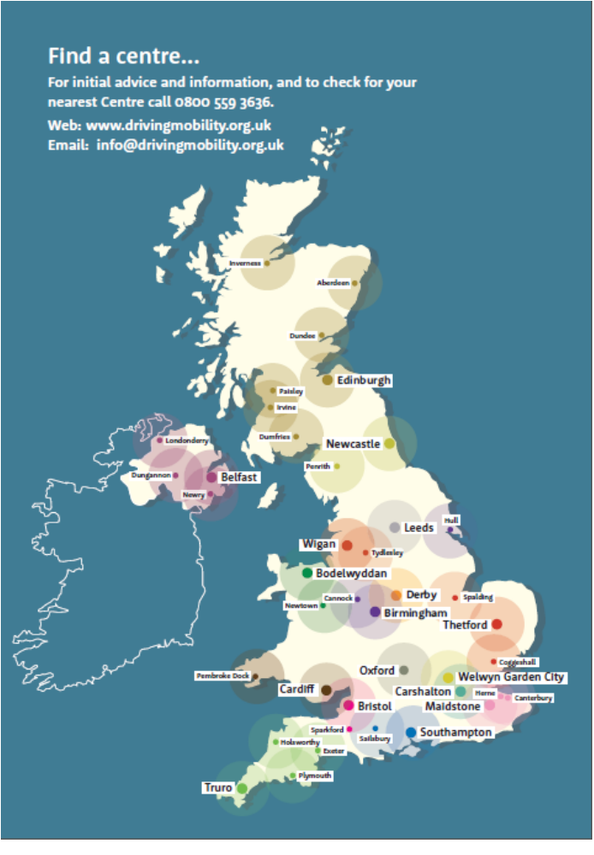

Case
DVLA
Leal
Telephone 0800 559 3636
between 9am and 5pm Mondays to Fridays
Manager
www.drivingmobility.org.uk
NHS
Motability

Slide 6
Referral sources
DVLA
Police
NHS
Case
Managers
Self
Motability
&
Private
Clinicians

Slide 7
Introduction of fee’s
RDAC lost funding to meet rising costs in 2025/26.
We are fortunate to get funding from DFT, but it costs around £500 for each assessment from referrals to report completion, the DFT funding leaves a gap of £190 per assessment.
Rising costs due to the budget, cost of living and increases from our suppliers etc, we can no longer cover this gap in funding to enable NHS patients not to incur any cost.
One of the last charity organisations within Driving Mobility to introduce a fee.
If a fee prevents someone from attending, we will endeavour to waive the cost.
We are keen to speak with NHS providers to see if they could help us by having a funding arrangement, or by referring us to a Health funding body. If you have any contacts, then please do let me know.
DVLA
Police
NHS
Self
Motability

Slide 8
Fee structure
DVLA
– fee covered
Police – fee decided by referring force
NHS -£40
Self
- £150
Case managers/private clinicians - £300
Motability – fee covered

Slide 9


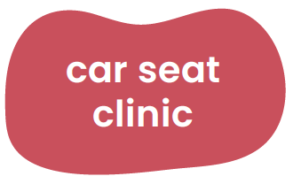
Services & Assessments
Driving
Assessments
Driving
School
Access Assessments
What we offer
Equipment Loading
Mobility
Scooters
Driving
Appraisals
Paediatric

Slide 10
Waiting times
Centre | Waiting Time | Waiting Time with Vetting
Cannock | 2 weeks | 3 weeks
Hull | 6 weeks | 13 weeks
Leicester | 4 weeks | 8 weeks
Manchester | 1 week | 2 weeks
Northampton | 3 weeks | 10 weeks
Oxford | 6 weeks | 11 weeks
Solihull | 2 weeks | 3 weeks
Wolverhampton | 2 weeks | 6 weeks
Worcester | 2 weeks | 4 weeks

Slide 11
Driving licence
Secretary of state for transport acting through DVLA, has responsibility to ensure all licence holders are fit to drive.
Unrestricted car licence is valid from 16-70 years of age. After 70 renewal every 3 years or frequent renewal on medical grounds.
Applicants and licence holders have a legal duty to:
  Notify of medical conditions, disabilities and/or illness.
  Comply with medical enquiries and restrictions of licence including renewal.

Slide 12
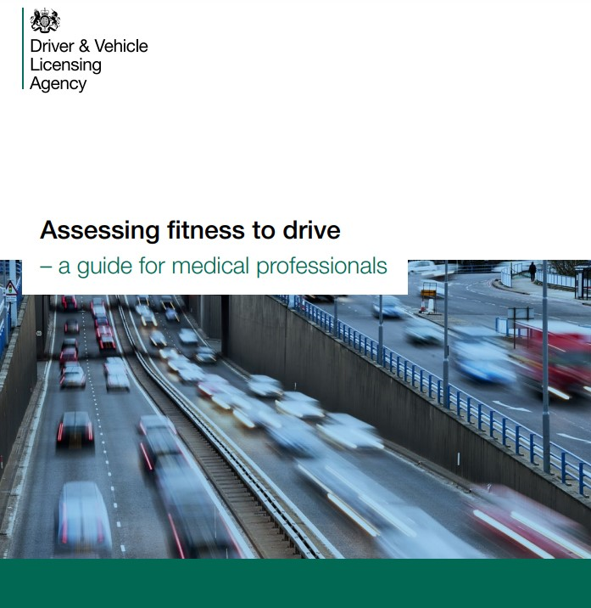
DVLA notifiable conditions

Slide 13
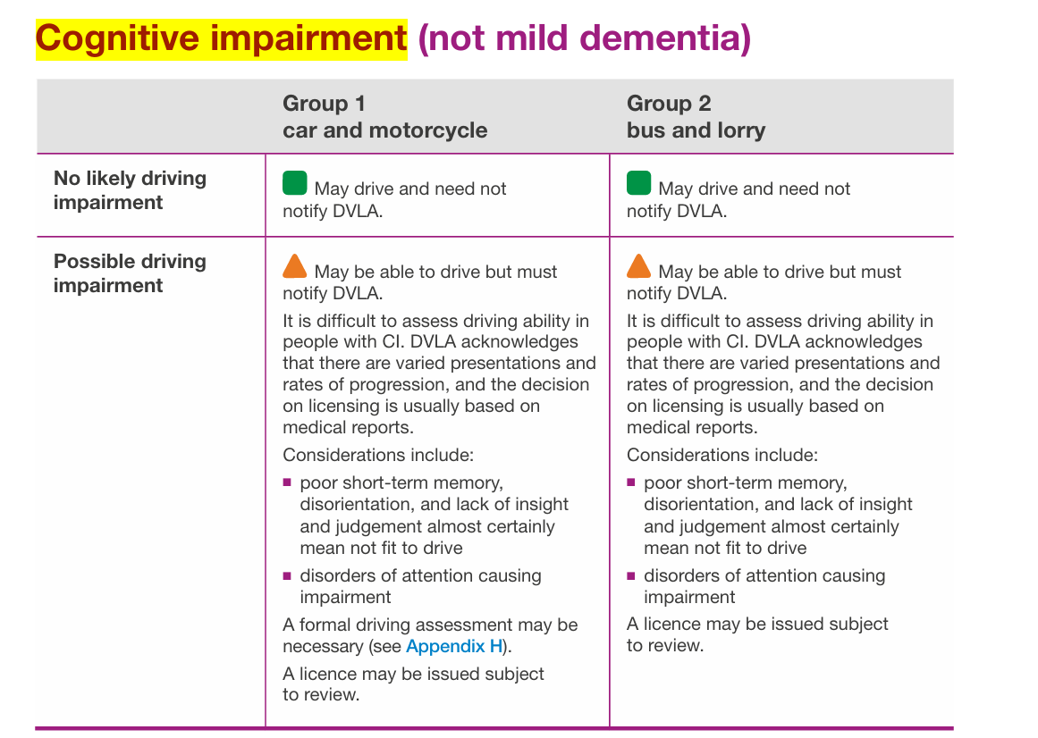
DVLA guidelines

Slide 14
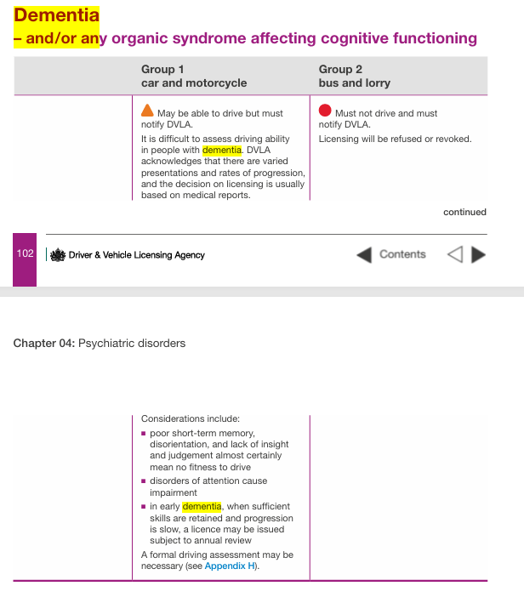
DVLA guidelines

Slide 15
Informing DVLA
It is the driver's responsibility to inform DVLA of a notifiable medical condition.
Medical professionals should:
Advise of the impact on safe driving ability
Advise the of the legal requirement
Notify DVLA directly of an individual’s medical condition or fitness to drive, where they cannot or will not notify DVLA themselves.

Slide 16

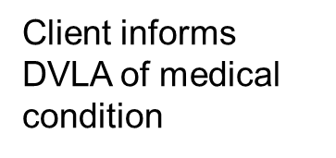
Medical Branch
Specialist Panel at DVLA
  Request information from GP and Consultant
  Consent from patient
  Review information
  Make Decision
  If DVLA unsure
  Patient appeal against DVLA decision
Mobility Centres
If Patient does not comply
- their license is revoked
  Assess client and Report to DVLA

Slide 17
Roles within the Mobility Centre
Driving Advisor (Approved Driving Instructor) - with the experience of driver behaviour and the training to identify and analyse driver faults along with training on medical conditions and their impact upon driving.
Occupational Therapist (OT) - with the experience of conducting activity analysis, assessing function; both physical and cognitive and the training to understand how medical conditions can impact upon a persons’ ability to drive safely.
Team working - Analysing the driver behaviour, against normal driver behaviour, identifying patterns and tentatively suggesting a possible area of impairment which then may or may not be related to a medical condition.

Slide 18
Driving Assessments
Medical fitness to drive assessment – review a person's ability to keep themselves, passengers and other road users safe. Whether this is following an accident, illness or change in medical condition.
Adaptation assessments - investigate vehicle modification options because of a physical disability such as a limb amputation or because an driver has become less able to drive using standard methods.

Slide 19

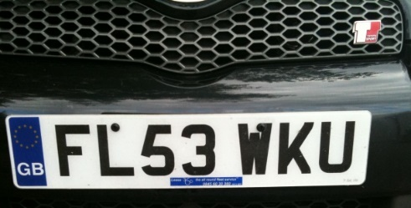





Visual Assessment
Interview
Physical Assessment
Cognitive Screen
Bert
physical & cognitive screening
Off/on road assessment
Assessment Process
Adaptations?
report & recommendations
on road assessment
debrief
Debrief
Report/
recommendations

Slide 20
Outcome and recommendations
1) High percentage of our clients are deemed safe to
continue driving. We also offer regular check-ups after the initial assessment for those with progressive conditions.
2) May recommend to a client that they are not currently safe, that they should take further recovery and/or tuition.
3) On occasion, we do have to inform clients to stop driving but we are here to support them with this!
Case
DVLA
Leal
Manager

Slide 21
1-1 shadowing
Information requests
Service presentations and training
Student visits and placements
Newsletter
0300 300 2240
www.rdac.co.uk
Thank you for listening

